Slide 1


#31daysofsummer
“DON’T COUNT THE DAYS,
MAKE THE DAYS COUNT”

Slide 2

Day 1: Monday 24th July
To celebrate the first day of the school holidays get outside and take a selfie with your friends.

Slide 3
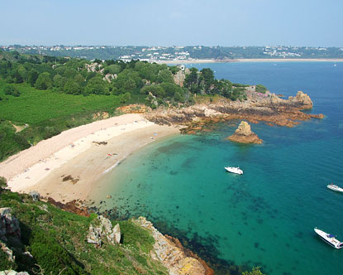
Day 2: Tuesday 25th July
Go enjoy one on the many beaches Jersey has to offer and show us your salty hair or sandy toes!
Salty Hair, Sandy Toes!

Slide 4
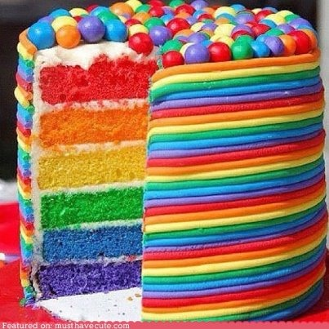
Day 3: Wednesday 26th July
Pat a cake. Pat a cake!
Show off your culinary skills and bake a cake.

Slide 5
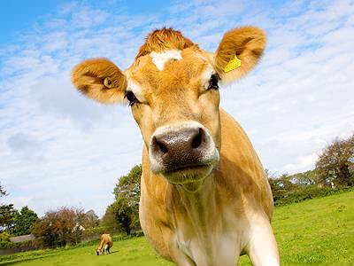
Good
mooo-rning!
Day 4: Thursday 27th July
Wake up in a good moooo-ed!!
Go for an explore in the lanes and get a picture of one of our famous Jersey cows!

Slide 6

Day 5: Friday 28th July
Love is in the air!
Pick up a pen and paper and tell someone you love them!

Slide 7

Day 6: Monday 31st July
Show appreciation for your parents by giving there car a good wash!
Show us a picture of their sparkly car.

Slide 8
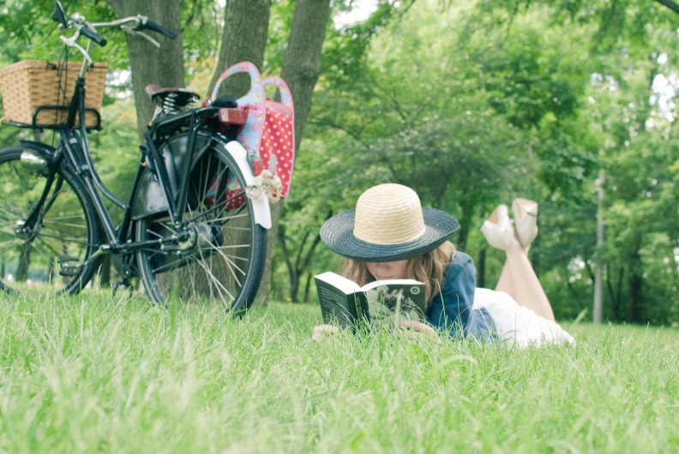
Day 7: Tuesday 1st August
Go catch some rays and relax in one of the many parks scattered around Jersey!
Don’t forget your sunscreen!

Slide 9
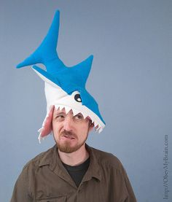
Day 8: Wednesday 2nd August
It’s Whacky Wednesday!
Show us a picture of you wearing the funkiest hat you can find!

Slide 10
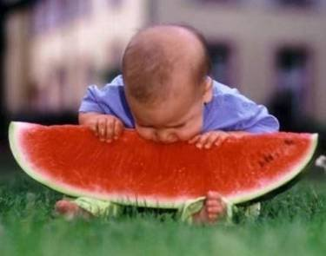
Day 9: Thursday 3rd August
#ThrowBackThursday
Share with us your favourite summer pictures of when you were younger and try to recreate them!

Slide 11
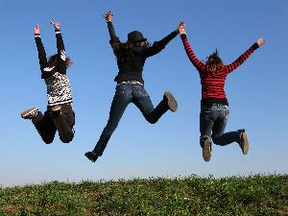
Day 10: Friday 4th August
This Sunday is International friendship day!
Everyone loves a jumping picture so share one with us on you and your friends!

Slide 12
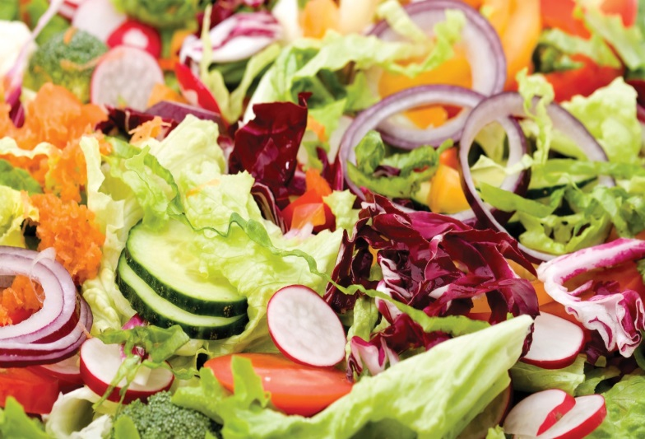
Day 11: Monday 7th August
Start the week off well by rustling up a healthy lunch!

Slide 13
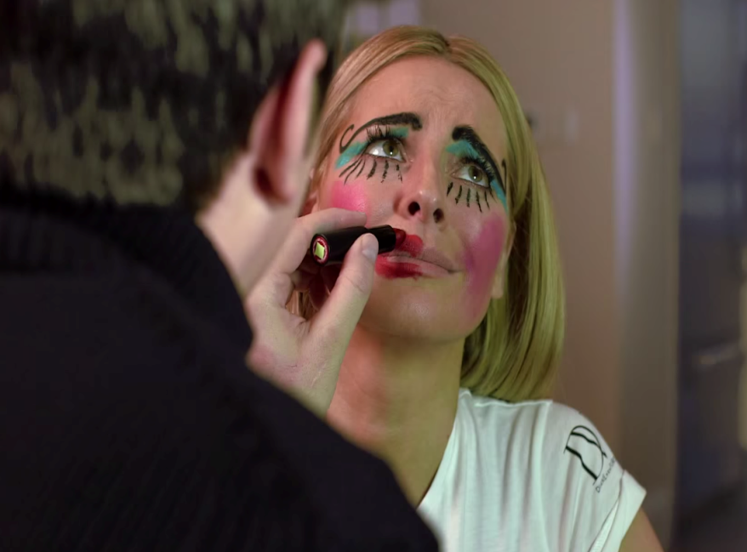
Day 12: Tuesday 8th August
Transformation Tuesday!
Have a rummage through the back of your wardrobe and give your friend a makeover!

Slide 14
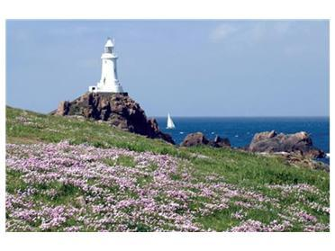
Day 13: Wednesday 9th August
Take a picture of your favourite place in Jersey.

Slide 15
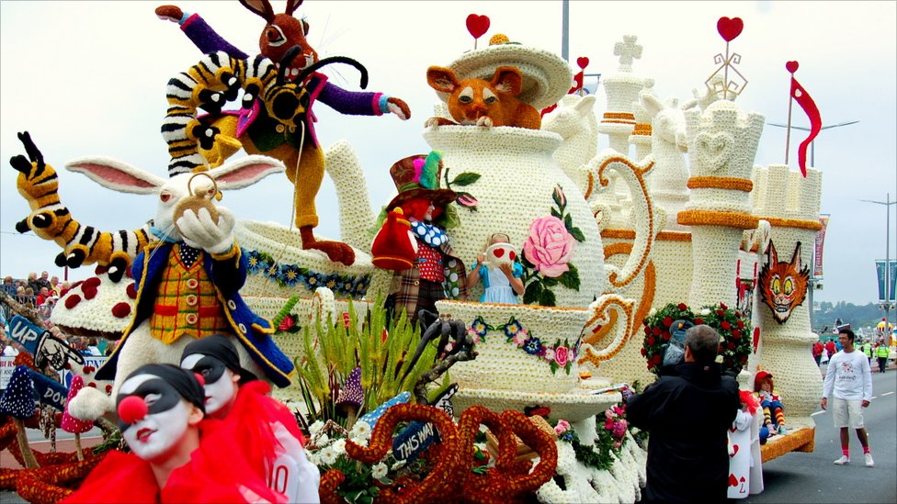
Day 14: Thursday 10th August
It’s the Battle of Flowers week.
Take a selfie with your favourite float.

Slide 16

Day 15: Friday 11th August
Look up at the sky tonight and take some shots of the fireworks from the Battle of Flowers!

Slide 17
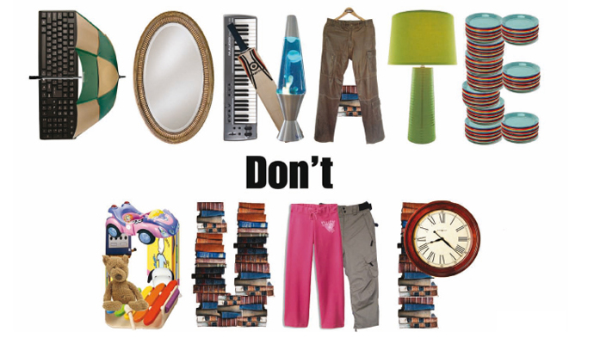
Day 16: Monday 14th August
It’s feel good Friday!
Go take a donation to a charity shop of your choice. Also feel free to show us any bargains you pick up on the way.

Slide 18

Day 17: Tuesday 15th August
Get over those Monday blues!
Share with us your favourite pick me up and positive quote!

Slide 19

Day 18: Wednesday 16th August
Build the tallest tower possible out of newspaper!

Slide 20
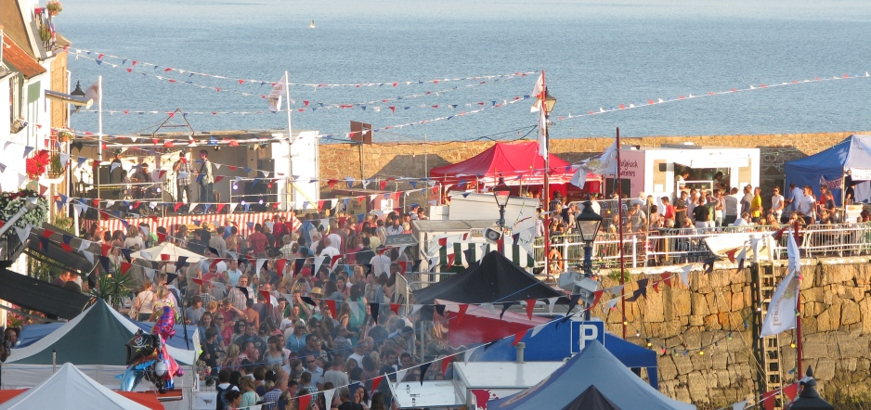
Day 19: Thursday 17th August
Get down to Gorey Fete where there will be lots of rides and fun to be had.
Send us a picture of you having fun!

Slide 21
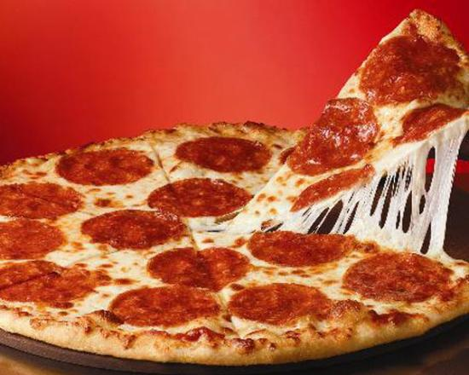
Day 20: Friday 18st August
It’s Fri-yay!!!
Invite your friends round for a meal to celebrate!

Slide 22
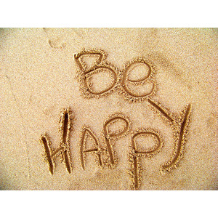
Day 21: Monday 21st August
Go down to the beach and write some happy words in the sand or with pebbles!

Slide 23
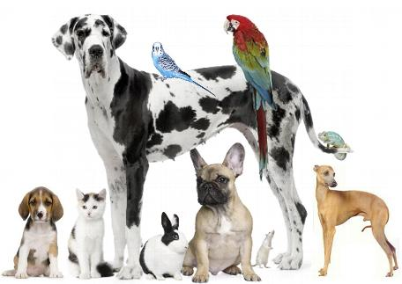
Day 22: Tuesday 22nd August
Show us a picture of you and your pet having a fun Tuesday!

Slide 24
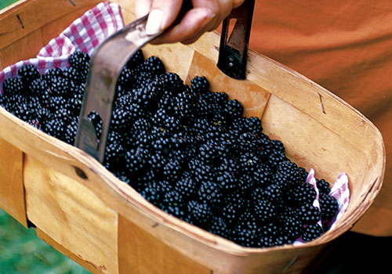
Day 23: Wednesday 23rd August
Go out blackberry picking and save them in your freezer as a treat!

Slide 25

Day 24: Thursday 24th August
Write a word or sentence on a piece of paper to sum up your summer so far!

Slide 26
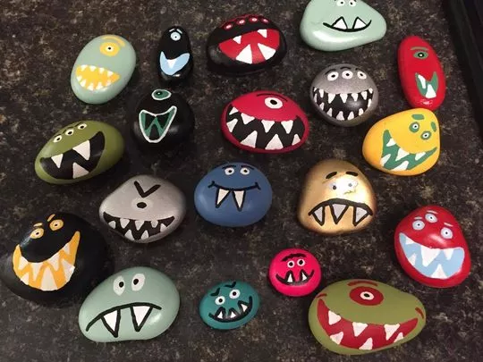
Day 25: Friday 25th August
Paint a rock with a funky design of your choice or as one of your favourite characters. Send us a picture of the final piece.

Slide 27
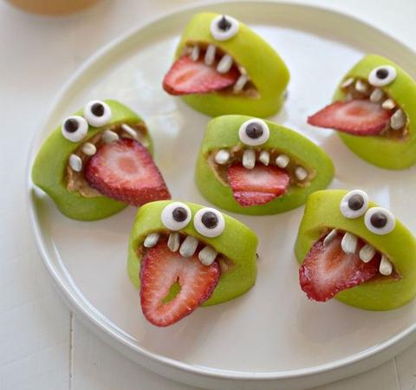
Day 26: Monday 28th August
Make a fruit monster!
Take your favourite fruits and transform them into crazy monsters, show us the final piece!

Slide 28
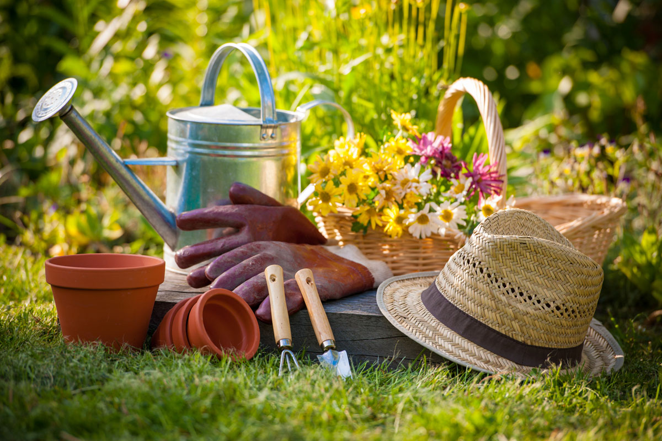
Day 27: Tuesday 29th August
Get Gardening!
Go outside and plant your favourite flower.

Slide 29
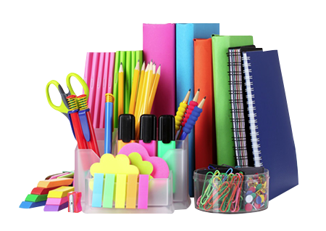
Day 28: Wednesday 30th August
School is just round the corner, show us any new stationary you have bought for the new school year!

Slide 30

Day 29: Thursday 31st August
As we come towards the end of summer, rather than think about school send us your favourite snap from summer!

Slide 31
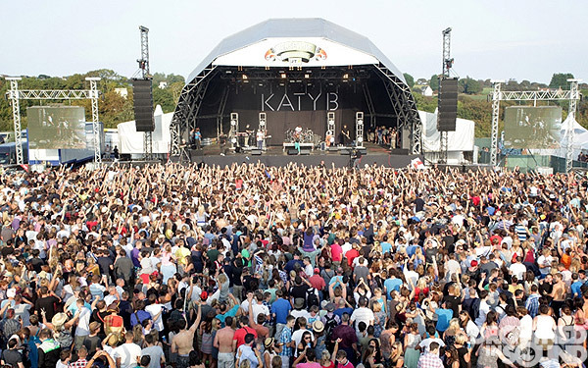
Day 30: Friday 1st September
Excited for the weekender?!
If your going show us your snazzy festival outfit

Slide 32

Day 31: Monday 4st September
It’s the last day of the summer holidays and the last day our our challenge ☹
Tell us what your favourite challenge was along with a picture of that challenge

